Slide 1




Sneaky Squirrel Team
Karam DALI
Melchior BAUDOIN
Muhammed-Adeel KHAN
Julien NOIREAUX-FATTAZ
Zakaria LATRECHE​

Slide 2

Table of Content :
System Architecture and Algorithmic Flow
Decision points
Electronic components
Project management

Slide 3
High-Level System Architecture (The "WHAT")
Mapping system
Path Planning System
Robot Control System
Mapping
Localization
Target cost estimator
Path planning algorithm
Main frame
Gripping
World model
Trajectory

Slide 4
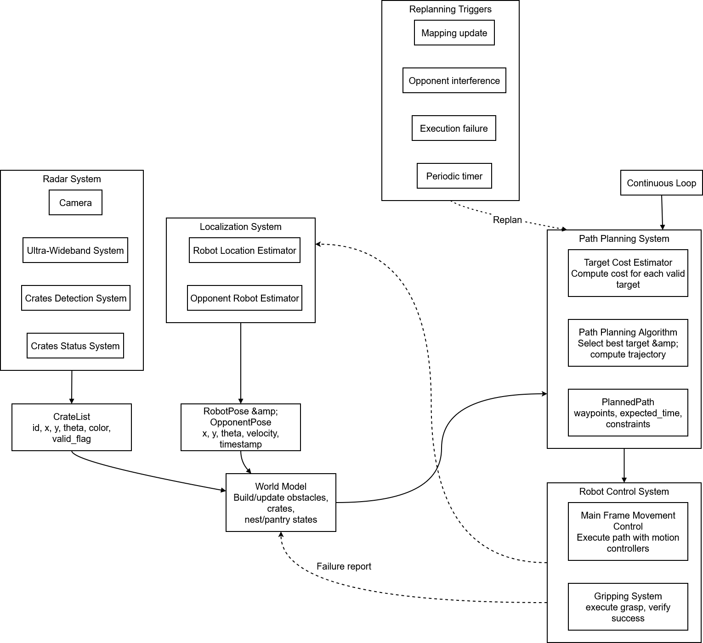
Core Algorithmic Flow (The "HOW")

Slide 5
Decision points
Is crate valid? (Mapping/Radar) → yes/no
Is nest capacity available? (Mapping) → choose nest or pantry in Cost Estimator
Opponent will reach crate sooner? (Localization/Path Planning) → select different target
Grip succeeded? (Control/Gripping) → if no: retry X times, else mark crate unavailable
Path blocked during execution? (Control/Main Frame) → local avoidance

Slide 6
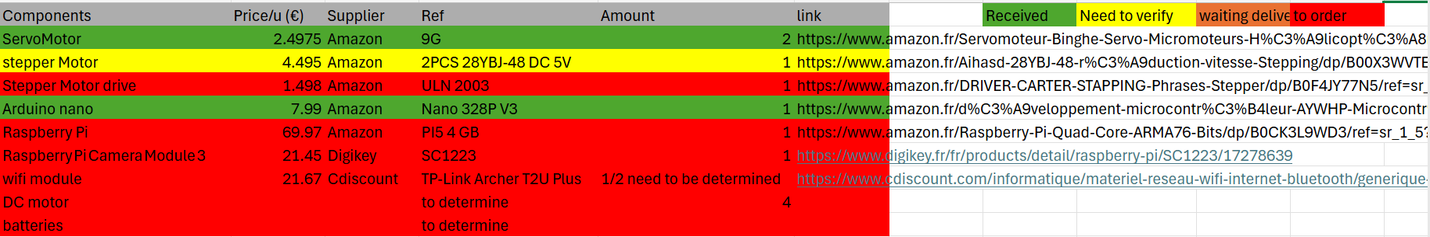
Electronic components

Slide 7
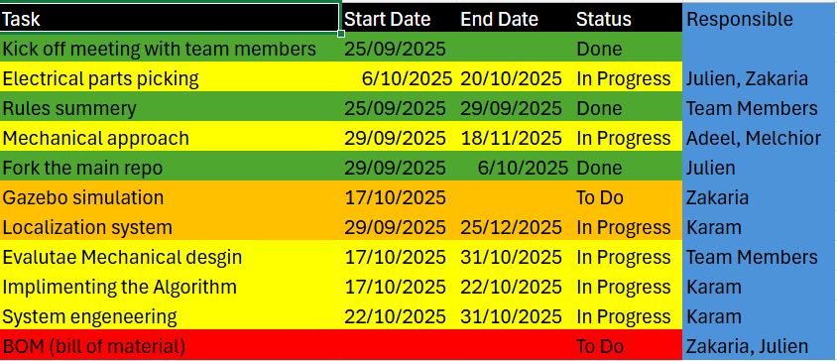
Project management

